Slide 1
Digital Portfolio
STUDENT NAME: Sashmitha M
REGISTER NO AND NMID: 2428C0512, 8D76B3D679D16878BF540593EEAFE870
DEPARTMENT: Bsc Ai&Ml
COLLEGE: KPR College of Arts & Science,Bharathiyar university

Slide 2
PROJECT TITLE
cloud engineer portfolio

Slide 3


AGENDA
Problem Statement
Project Overview
End Users
Tools and Technologies
Portfolio design and Layout
Features and Functionality
Results and Screenshots
Conclusion
Github Link
3/21/2024 Annual Review

Slide 4

PROBLEM STATEMENT
Manual deployment of applications on cloud is time-consuming and error-prone.
Real-time communication requires scalability and secure authentication.
Developers need a personal digital space to showcase skills and projects

Slide 5

PROJECT OVERVIEW
Automated web application deployment on AWS using Terraform and Jenkins.
Built and deployed a Node.js & Socket.io real-time chat app on AWS EC2.
Designed and developed a responsive portfolio website to present skills, projects, and contact details.

Slide 6

WHO ARE THE END USERS?
Cloud Deployment Automation: Developers, DevOps Engineers, Enterprises.
Chat Application: Students, Professionals, and Organizations needing real-time communication.
Portfolio Website: Recruiters, Hiring Managers, Academic Mentors.

Slide 7

TOOLS AND TECHNIQUES
Cloud & DevOps: AWS, Terraform, Jenkins, Docker, Kubernetes
Programming & Frameworks: Node.js, React.js, JavaScript, HTML, CSS
Others: Linux, Networking, CI/CD Pipelines

Slide 8
POTFOLIO DESIGN AND LAYOUT
Clean and responsive design.
Simple navigation: About, Skills, Projects, Contact.
Interactive UI with categorized skills and projects.
8

Slide 9
FEATURES AND FUNCTIONALITY
Automated deployment reduced time by 40%.
Real-time chat app with secure authentication & auto-scaling.
Portfolio website showcasing projects, skills, and contact form.

Slide 10

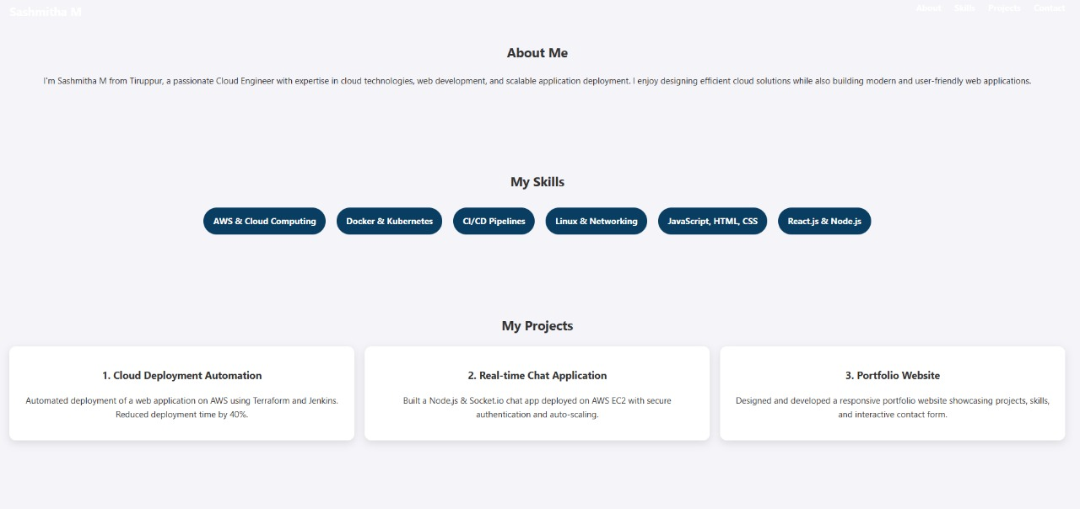
RESULTS AND SCREENSHOTS
Successfully deployed and tested projects on AWS.
Scalable and secure applications with efficient deployment.
Fully responsive portfolio accessible across devices.
3/21/2024 Annual Review
10

Slide 11
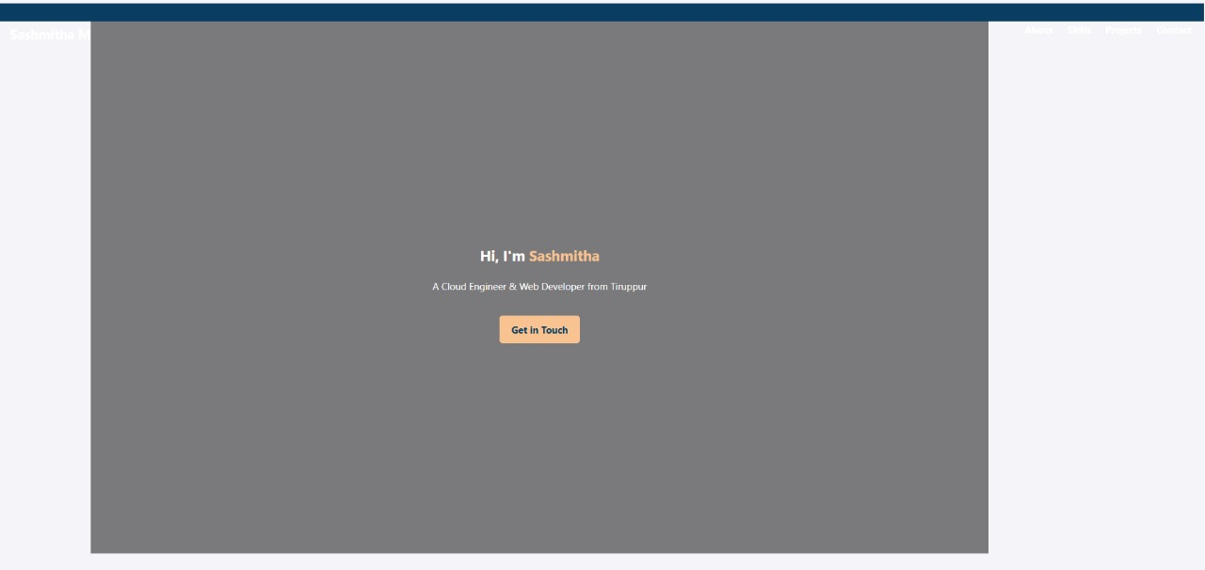

RESULTS AND SCREENSHOTS

Slide 12
CONCLUSION
Gained expertise in cloud computing, DevOps, and full-stack development.
Projects demonstrate both technical skills and problem-solving ability.
Portfolio provides a professional digital identity for career opportunities.
12

Slide 13
Git hub Link:
portfolio Repository :
https://github.com/SashmithaM

